Slide 1
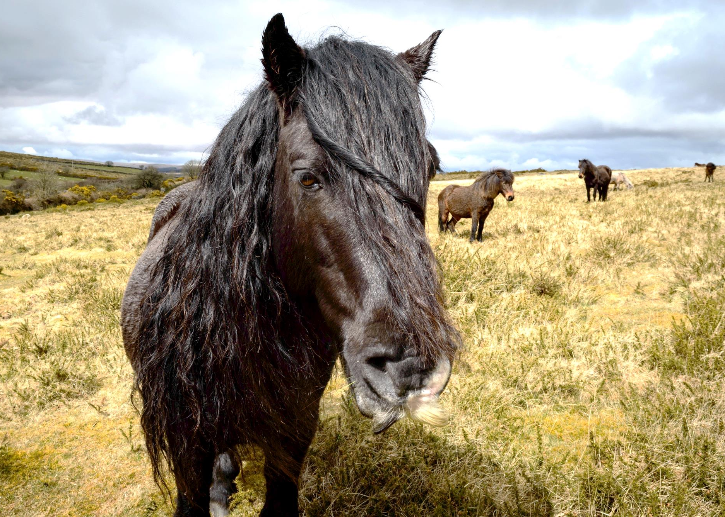
A Keystone Species The Dartmoor Hill Pony
‘Essential components of the ecosystem’
Chris Packham, Springwatch 2020

Slide 2
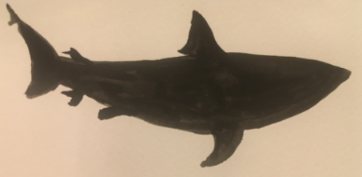
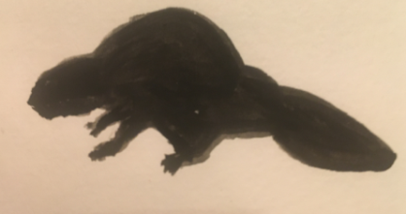
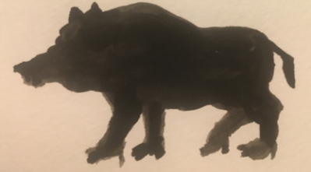
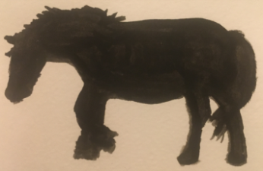
What is a keystone species?
‘Every ecosystem has certain species that are critical to the survival of the other species in the system. The keystone species could be a huge predator or an unassuming plant, but without them the ecosystem may not survive.
In any arrangement or community, the “keystone” is considered one
of the most vital parts. Without its keystone species, ecosystems would look very different. Some ecosystems might not be able to adapt to environmental changes if their keystone species disappeared. That could spell the end of the ecosystem, or it could allow an invasive species to take over and dramatically shift the ecosystem in
a new direction.’
National Geographic

Slide 3
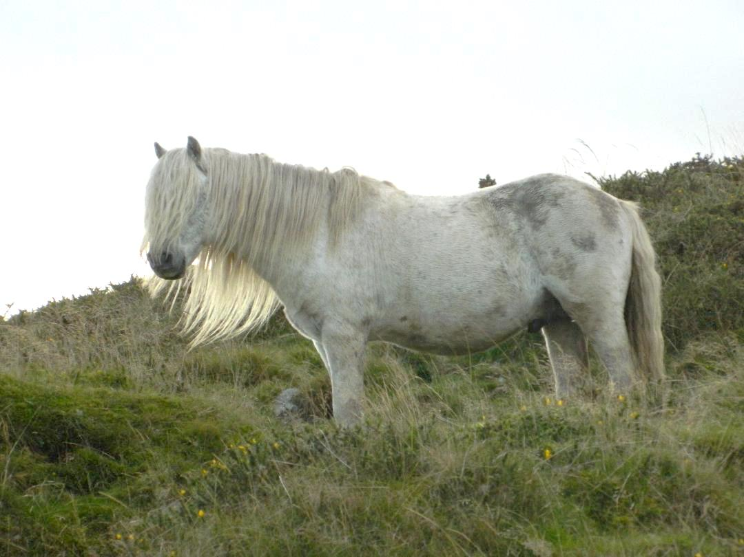
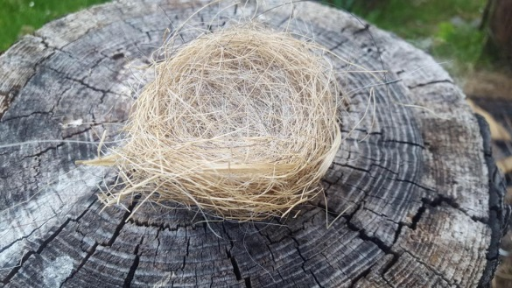
The Dartmoor Hill Pony A Keystone Species
Exceptional memory allows ponies to find food throughout the year and follow set routes across
the moor for minimum impact on the environment,
helping to preserve bogs, wetlands and woodlands, and
the rare flora and
fauna that live there.
Prehensile upper lip is able to carefully select particular plants, allowing biodiversity
to thrive.
Short, strong legs cover difficult terrain with ease. The ability to travel to find diverse food sources helps maintain Dartmoor’s landscape.
A highly effective digestive system means ponies are able to survive on less, and lower quality, food than cattle and sheep.
Mane and tail collect and disperse seeds and pollens. Birds also use mane and tail hair to build durable nests for young.
Small hooves have minimal impact on
the surface
of the moor.
Nutrient-rich dung provides food for many insects, including essential pollinators
like bees.

Slide 4
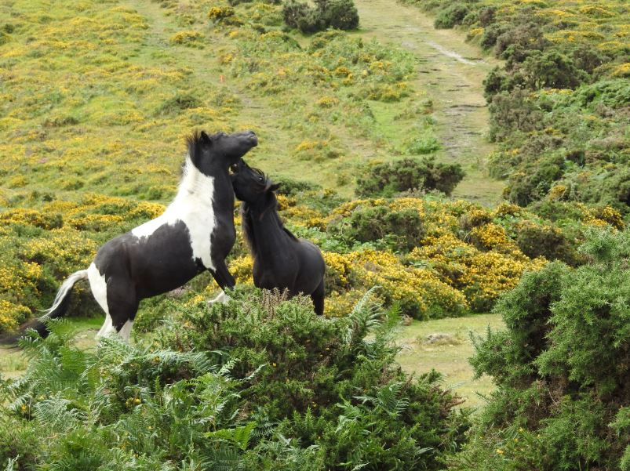
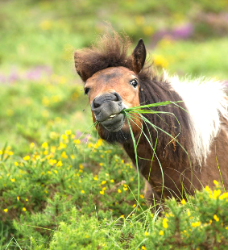
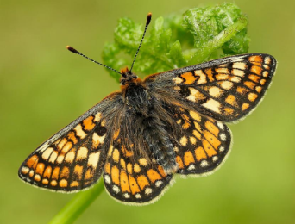
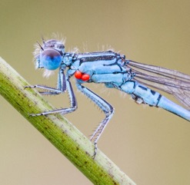
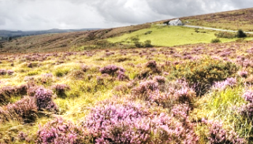
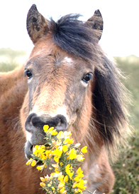
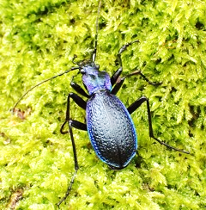
Controlled
grazing ensures
the survival of rare habitats, like Rhôs
pasture, where threatened species, like the Marsh Fritillary Butterfly, thrive.
During the summer, purple moor grass, scarcely eaten by cattle, makes up 20% of
a Dartmoor Hill Pony’s diet. In the UK,
the spread of purple moor grass has frequently been at the expense of more diverse upland heath and mire habitats.
Dartmoor Hill Ponies maintain woodlands and marshes which are home to newly discovered species like Heckford’s Pygmy Moth and the globally threatened Southern Damselfly.
They avoid heather, which invaluable pollinators like bees thrive on, and which grazing prescriptions
often aim to protect.
Dartmoor Hill Ponies like to graze on gorse, which heathland grazing prescriptions often aim to control.
Conservation grazing in places like Yarner Wood helps ensure the survival of rare species such as the Blue Ground Beetle, listed as near-threatened on the IUCN
Red List.

Slide 5
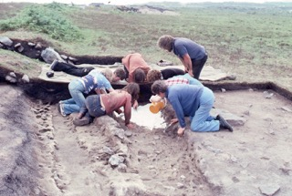
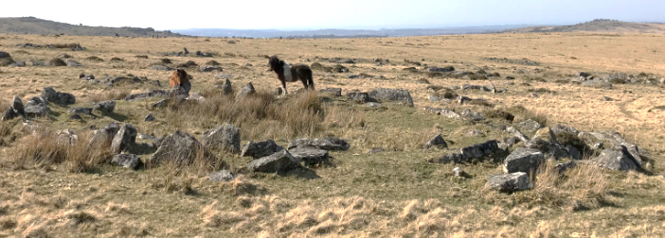
A Brief History
Archaeologists unearth
ancient hoof prints
Evidence suggests ponies were roaming Dartmoor as far back as 500, 000 years ago, during the Ice Age. Dartmoor Hill Ponies have been living and working alongside humans since the Bronze Age. There is archaeological evidence that cattle, sheep and ponies were being farmed together on Dartmoor around 1350 BC.
The Dartmoor Pony became a registered breed at the start of 20th century. Humans began to impose rules on what this new breed of pony should look like, mixing the pure bloodline of the semi-wild ponies with breeds such as the Hackney to make them more saleable and showable. At this point, the life of the Dartmoor Hill Pony separated from the life of the Dartmoor Pony.
While the Dartmoor Pony is a name given
to a type of pony whose life is almost
completely controlled by humans, from
where it is born to who its breeds with,
the Dartmoor Hill Pony is born and breeds
independently of humans, running free
on Dartmoor.
Dartmoor Hill Ponies at Bronze Age Settlement

Slide 6
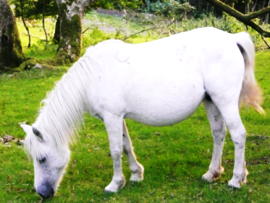
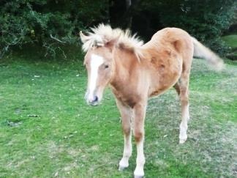
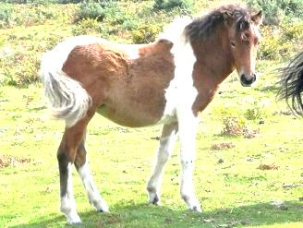
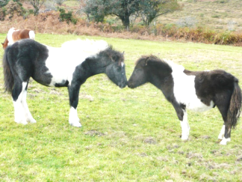
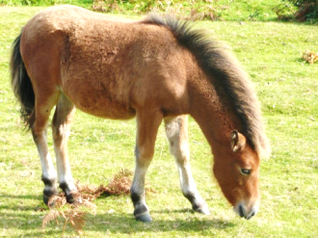
Genetics
All registered breeds of animals are biologically far less valuable than those that are not. This is because registered breeds have been bred and controlled by humans. Dartmoor Hill Ponies are not a recognised pony breed, which means their genetics are incredibly valuable because humans have not interfered with them.
Apart from being wonderful companions and workers for humans, Dartmoor Hill Ponies have a genetic code that gives them a double-layered winter coat, complete with a moustache, a metabolism that helps them build lifesaving fat reserves on sparse grazing through the winter.
And these precious genetics are all the
more precious for what we still do not
know about Dartmoor Hill Ponies, and
how they have survived and thrived for
so long and with so little interference
from humans.

Slide 7
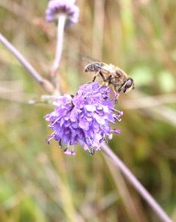
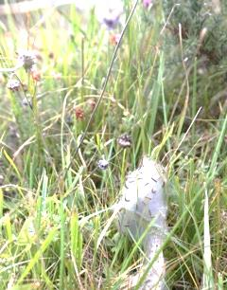
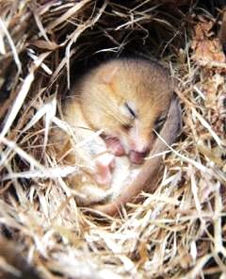
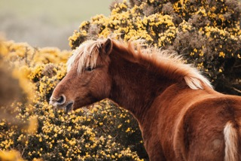
Biodiversity
Dartmoor Hill Ponies are invaluable champions of the moor’s biodiversity. Without their unique grazing habits, invasive species like bracken, gorse and purple moor grass quickly spread across the moor, pushing out other plant species and damaging habitats. During summer, purple moor grass makes up 20% of a Dartmoor Hill Pony’s diet. In the UK, the spread of purple moor grass is often at the expense of more diverse upland heath and mire habitats.
The ponies’ grazing habits also create varied height and structure in
the sward so that rare species like the dormouse, the March Fritillary Butterfly, Heckford’s Pygmy Moth and the globally threatened Southern Damselfly can thrive in sheltered niches and the warm micro-climate at ground level.
‘Maintaining or improving the quality of these
habitats and developing the natural networks
which emanate from them, should be the focus
of site management.’
Succisa pratensis -
the diet of Marsh Fritillary larvae
Marsh Fritillary larvae web
in the sward
dartmoor.gov.uk

Slide 8
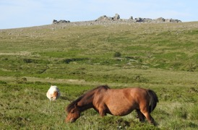
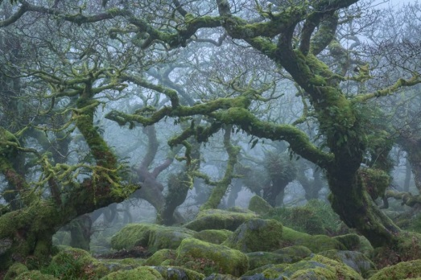
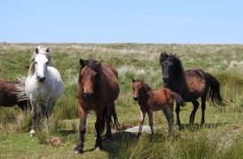
Landscape
No image of Dartmoor is complete without a Dartmoor Hill Pony. The iconic logo for Dartmoor National Park is based on the noble profile of these beloved ponies.
Hardy and independent enough to survive the harshest high altitude winters, with thick coats and self-maintaining hooves, Dartmoor Hill Ponies have an innate knowledge that allows them to source food and water when other breeds of pony, not to mention cattle or sheep, would perish.
Dartmoor Hill Ponies have particular areas that they
call home and the way they graze changes throughout
the seasons to naturally make best use of the available
food supply, eating the moor grasses that are in
abundance in summer and spreading out and grazing
on gorse and bracken in the winter. To allow their
herds to remain on Dartmoor with the minimum
amount of interference helps to ensure the survival
of this unique landscape. Studies have shown that
pony grazing is essential in supporting many rare and
endangered species on Dartmoor.
Notes:
Recognising the potential role of native ponies in conservation management Stanley, Christina R.; Fraser, Marecia; Hegarty, Matt

Slide 9
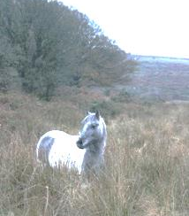
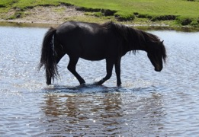
Health and Wellbeing
Dartmoor Hill Pony in a peat bog
‘Dartmoor is the principle source for water to much of Devon, with many of the county’s rivers emanating from the high moors and eight reservoirs supplying most of the population. Dartmoor’s deep peat is a store for 10 megatonnes of carbon – the equivalent of one year of CO₂ output from the industry in the UK. Areas of deep peat in good condition continue to sequester more, helping to mitigate against future changes in climate, whilst eroding areas continue to lose this precious resource.’
dartmoor.gov.uk
By grazing sensitively and intelligently, Dartmoor Hill
Ponies not only promote biodiversity, they also protect
the landscape as a whole. By helping to maintain the
natural balance on Dartmoor, these ponies play a part
in our health and wellbeing both locally and globally.

Slide 10
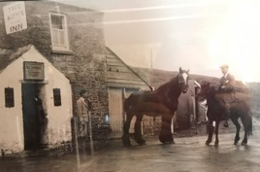
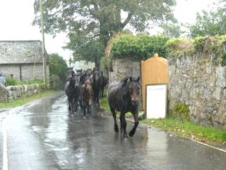
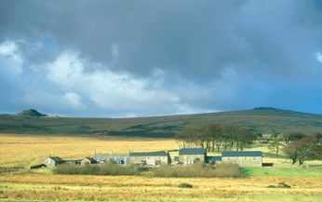
Tourism
‘Ask any visiting tourist to describe Dartmoor and the word ‘ponies’ will be said within the first three sentences.’
Peter Parsons, landlord of Warren House Inn for 25 years
‘Tourism is worth over £100m a year to the local economy of Dartmoor National Park and supports nearly 2000 full-time jobs.’
DEFRA
‘The beauty of the Dartmoor landscape draws millions of people to visit the National Park every year for a wide range of activities and there is a knock on benefit for a wide range of local businesses, including food and drink producers, accommodation providers and activity centres.’
dartmoor.gov.uk
Tourists flock to Dartmoor to see its ponies and there is a detailed Dartmoor Hill Pony exhibition at Powerdermills Pottery, near Postbridge.
Warren House Inn, Dartmoor
Ponies head to the pub in the summer rain
Powdermills Pottery

Slide 11
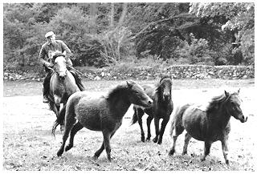
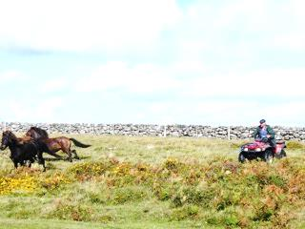
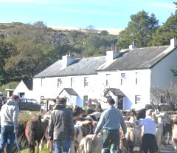
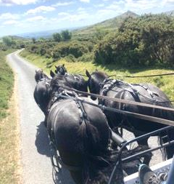
Culture
Dartmoor Commoners have kept a watchful eye over these amazing ponies for generations. In fact, each pony born on the moor has an owner. These expert pony keepers have the year-round task of ensuring the herds are safe and well.
In the October drift, the ponies are rounded up and brought down from the moor to be counted, checked over and, in some cases, sold.
Dartmoor Hill Ponies make wonderful riding and driving ponies. Also, interest in ponies as a local, free-range and sustainable food source is growing.
Academic research has proven beyond doubt the critical value of these ponies but it is the Dartmoor Pony Keepers who have the ultimate responsibility for them. It is their expert knowledge that ensures that these precious herds and the moor that they preserve live on for ever.

Slide 12
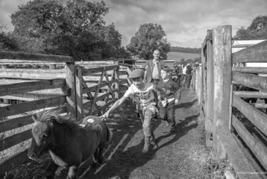
Skills and Language
Countless pony handling skills are passed down from each generation of Commoners to the next. During the annual Drift, Commoners work symbiotically with their hill ponies herds to follow set routes off the moor. The October Drift Sale in Chagford is the only sale of its kind that still takes place on Dartmoor. It has been happening for 700 years. Drift Sale ponies are still sold in guineas and each member of a herd can be identified by a special mark, given to it by the Commoners.
Pied Black and white pony
Drift lane the route the ponies follow down off the moor during the drift
Ear notches sections or shapes cut out of a pony’s ear to make it easy to identify
Guinea 21 shillings or £1.05
Hot branding using red hot metal to burn the pony owners individual symbol onto the pony, making pony easy to identify.
Lear an area that ponies are specially trained to graze in
Pound the enclosure where Commoners gather, separate off and check their herds of ponies
Tail cuts sections cut out of a pony’s tail to make it easy
to identify

Slide 13
Photographic Acknowledgements
Page 1: ‘Midnight’ © Sarah Jane Norrish
Page 3: Grey stallion © Pam Clifford(main); Horse-hair bird’s nest © Joss Hibbs (inset)
Page 4: Fighting stallions © Pam Clifford(main image); Pony eating purple moor grass © Charlotte Faulkner (inset); Marsh Fritillary Butterfly © Butterfly Conservation (inset); Heather © Nick Dunstone (inset); Southern Damselfly © philhutt@dartmoorpreservation.co.uk (inset); Bay pony eating gorse ©Sarah Jane Norrish (inset); Blue Ground Beetle © Steven Falk (inset)
Page 5: Archaeological dig © Ossiie Palmer; Ponies at Bronze Age settlement © Charlotte Faulkner
Page 6: Various Dartmoor Hillies © Friends of the Dartmoor Hill Pony
Page 7: Succisa pratensis with bee © Richard Austin; Marsh Fritillary larvae web © Richard Austin Dormouse © Richard Austin; Palomino pony eating gorse © Kristina Maier
Page 8: Ponies and tor © Pam Clifford; Wistman’s Wood © Adam Burton;
Ponies on the moor © Pam Clifford
Page 9: Dartmoor Hill Pony in a peat bog © Charlotte Faulkner; Pony in a river © Pam Clifford
Page 10: Warren House Inn © with thanks to Warren House Inn; Ponies head to the pub © Charlotte Faulkner; Powdermills Pottery © Ossie Palmer
Page 11: Cyril Abel rounding up ponies, Moortown Farm, Whitchurch ©Chris Chapman 1978; Rounding up the ponies on a quad bike © Charlotte Faulkner; Commoners at the Drift © Charlotte Faulkner; Driving ponies © Lucy Thomas
Page 12: At Chagford Pony Sale, Dartmoor © Chris Chapman 2019

Slide 14
Sources
https://publications.parliament.uk/pa/cm201719/cmpublic/Agriculture/memo/AB49.pdf
https://whittle.woodlandtrust.org.uk/2019/04/14/a-year-at-east-dartmoor/
https://phys.org/news/2019-11-ponies-critical-role-dartmoor-future.html
https://chesterrep.openrepository.com/handle/10034/622187
dartmoor.gov.uk
https://assets.publishing.service.gov.uk/government/uploads/system/uploads/attachment_data/file/69310/pb13533-national-park-authorities.pdf
National Geographic

